Slide 1
Automation of reporting process

Slide 2
Automation of reporting process
It is required to send weekly management reports based on the received data on bank activities.
Notes:
There is a huge number of documents that may contradict one another. Huge amounts of data are received by the directories every minute, and the information needs to be presented in some other format. The servers are overloaded, some of them collapse, some of them have the net broken down. Each manager needs certain information in a certain format. The management demands this information from the economists, who have to explain the requirements to the programmers, thus the misinterpretation is quite likely to happen. The same programmers are required to ensure that the information comes from the customers with no delay during working hours. This is why the speed of reporting queries is limited.

Slide 3
MS Sharepoint + MS Reporting Services
Notes:
To solve this problem there can be created a separate directory to receive the reporting data with a one-day delay. Besides, for these needs there can be established a web portal based on MS Sharepoint with an integrated MS Reporting Server.

Slide 4
Which type of report is needed?
Notes:
Types of reports are constantly changing, each type needs a different data slice. The number of reports at the portal begins to rapidly increase, which leads to the problem--the report seems to be there, but it is very difficult to find. Various briefings and meetings often require very limited data sets, or the report is preferable to be presented as a graph rather than as a table.

Slide 5
Using MS Analysis Services
Notes:
For those purposes were used the MS Analysis Services and its Excel tools support, such as spreadsheets as well as various graphs and charts based on spreadsheets. While working with them the user can choose which option out of the list of proposals they want to see and the form of its implementation.

Slide 6
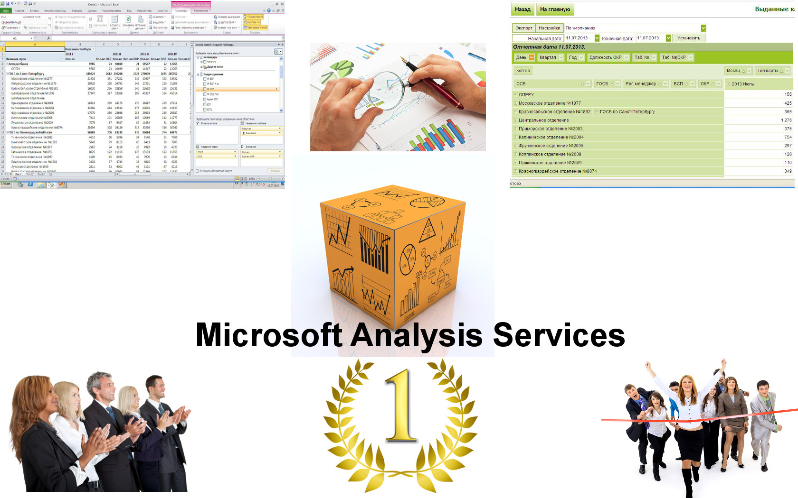
Two Employee of the Year awards for OLAP
Notes:
First, I was awarded as the Employee of the Year for implementation and managing of the MS Analysis Services, and the next year the same award went to a Central Office employee who adopted my implementation experience. The advantage of the OLAP solution based on the MS Analysis Services platform is that every employee can connect to OLAP cube through Microsoft Excel and generate the report they need.

Slide 7
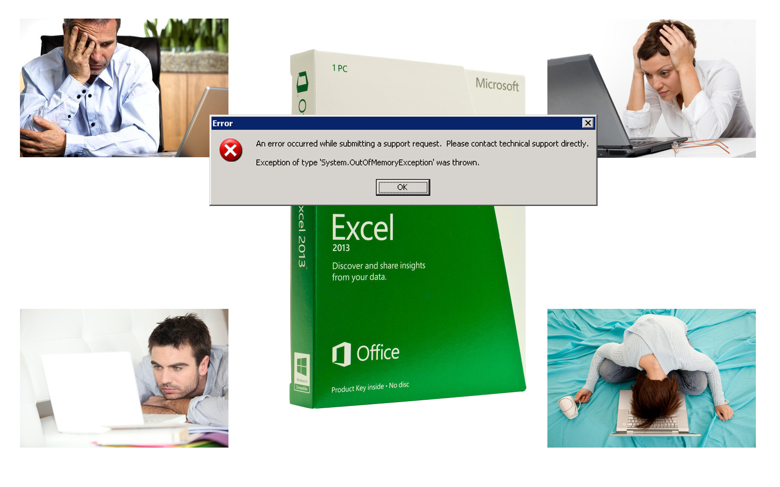
Large number of reports, little memory.
Notes:
During the working process we encountered several problems. The first occurred when it was required to generate a report with maximum detail. For example, full information about the creditors, starting from the passport details up to the manner and time of loan. Moreover, the information concerned a random period of time. As a result, the generated reports contained large amount of data, which in some cases led to the inability to perform the report due to the memory overflow. For the same reason they were difficult to work with via the MS Analysis Services.

Slide 8
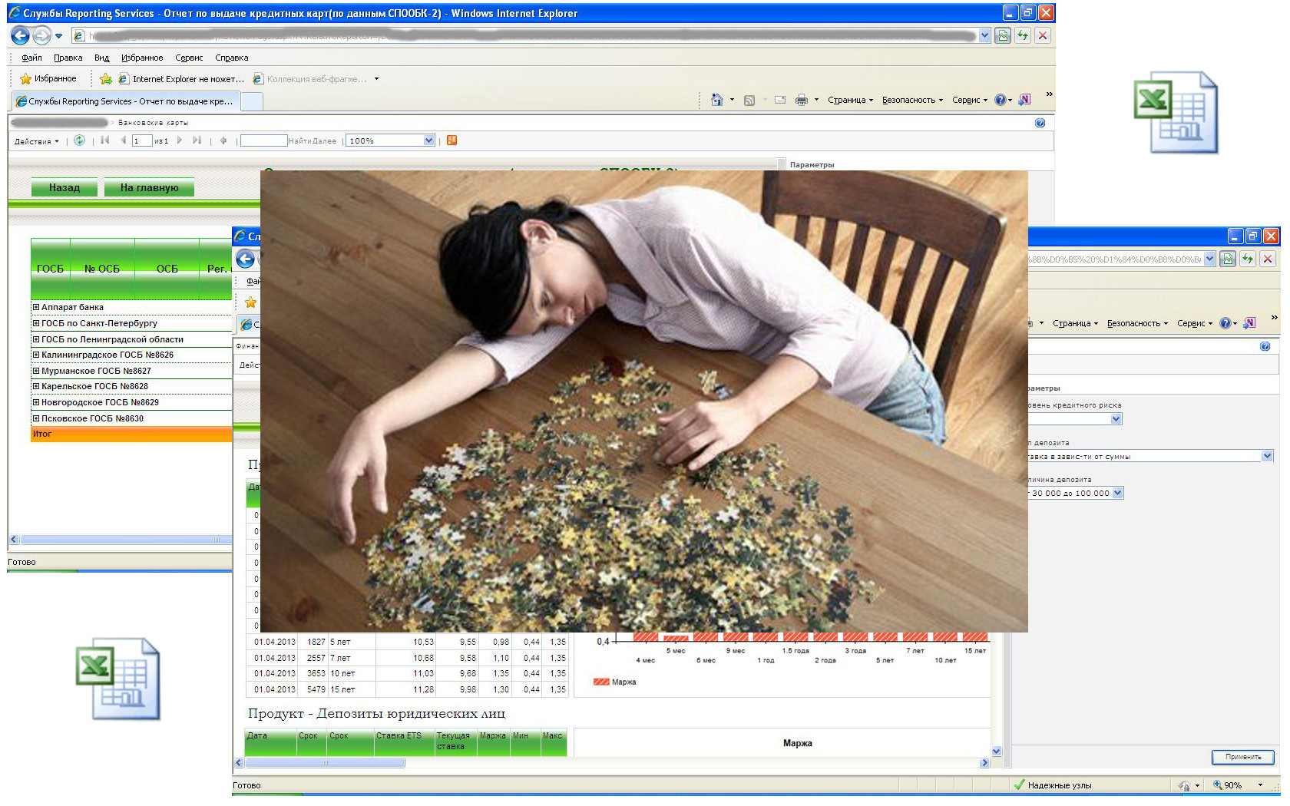
Collect only what is needed.
Notes:
The second problem was that the users took reports from the portal to form some other reports, so they exported the report to MS Excel, then took individual pieces out of it and used them for their own purposes. In this case, the report's layout lost its meaning and more time was required to run it on the portal and then to export it to MS Excel. The third problem concerned the generating of summary reports in MS Reporting. The MS Reporting tool presents an opportunity to generate summary reports with the ability to view attachments. On the website it looks very convenient and allows to quickly analyze all the segments of the report. Difficulties arise when such report is exported to MS Excel to try and get the data of another cut set. Due to the large amount of data the processing speed in Excel drops significantly.

Slide 9
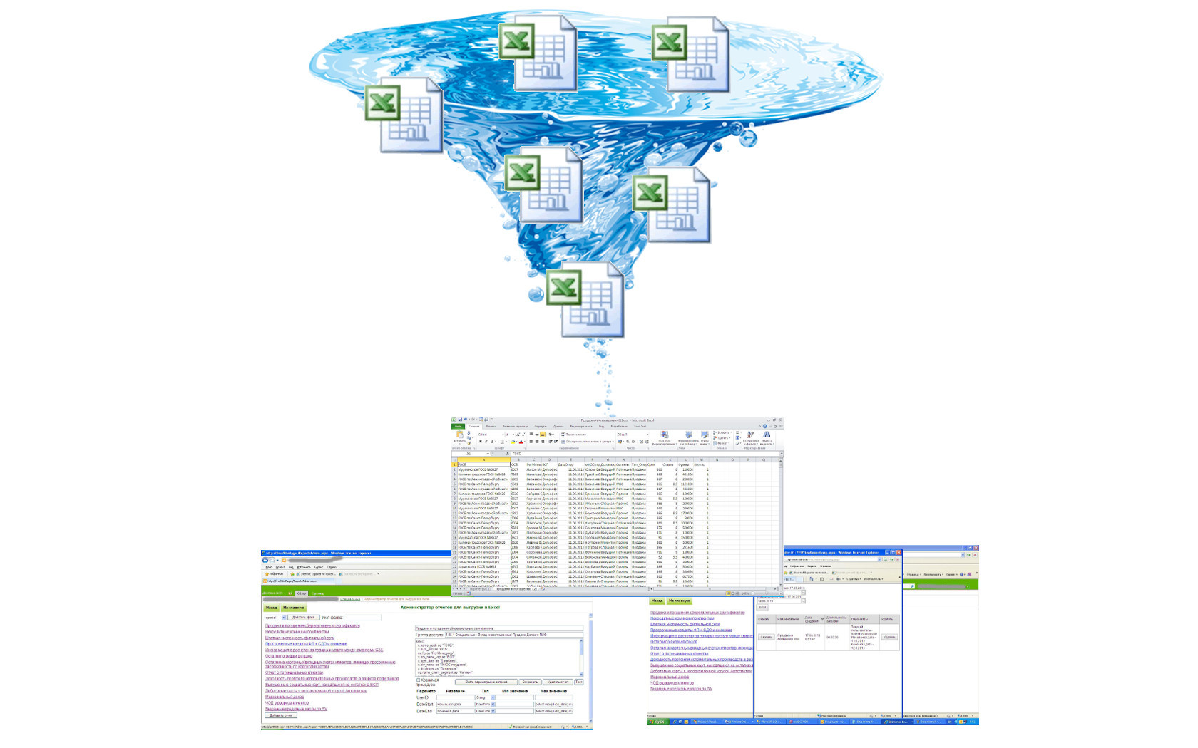
Reports exported to MS Excel directly
Notes:
Solution to this problem has been the development of Internet applications that immediately provided reports to the user as the Excel files generated on the server. Generation of the file was to be executed in the in-line mode, when the data was immediately saved to the drive, without any black-outs to the random-access memory. For further convenience, the Report Builder and a user interface were created for this application. This application functioned similarly to the MS Reporting Server, but unlike it, it could generate the reports directly to the Excel file using the minimum hardware resources of the server. Summary reports were not generated in the file. It only contained flat detailed uploads that could serve as the basis for generating summary reports, whenever the need arose.

Slide 10
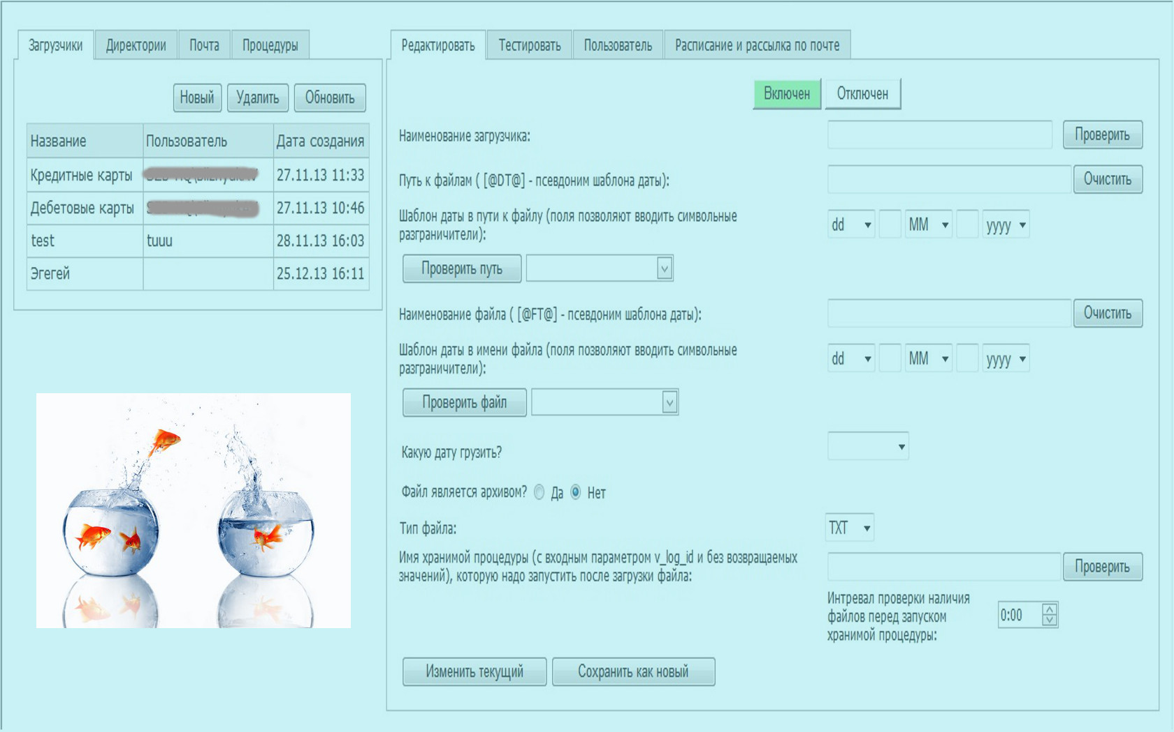
Uploading data from the file to the database.
Notes:
During the working process, primary data sources began to appear as the files of various formats. It could be various services that were not automated and information on them was maintained manually in the form of Excel spreadsheets; or information due to some certain considerations could not be transmitted in any way except in the form of files; or different uploads from the closed automated systems that did not allow to pass the information directly from the database. Thus, where possible, it became common to load information from the files using the MS Integration Services; and if it was difficult or impossible, there was developed a programme for uploading files of random formats to the Oracle database.

Slide 11
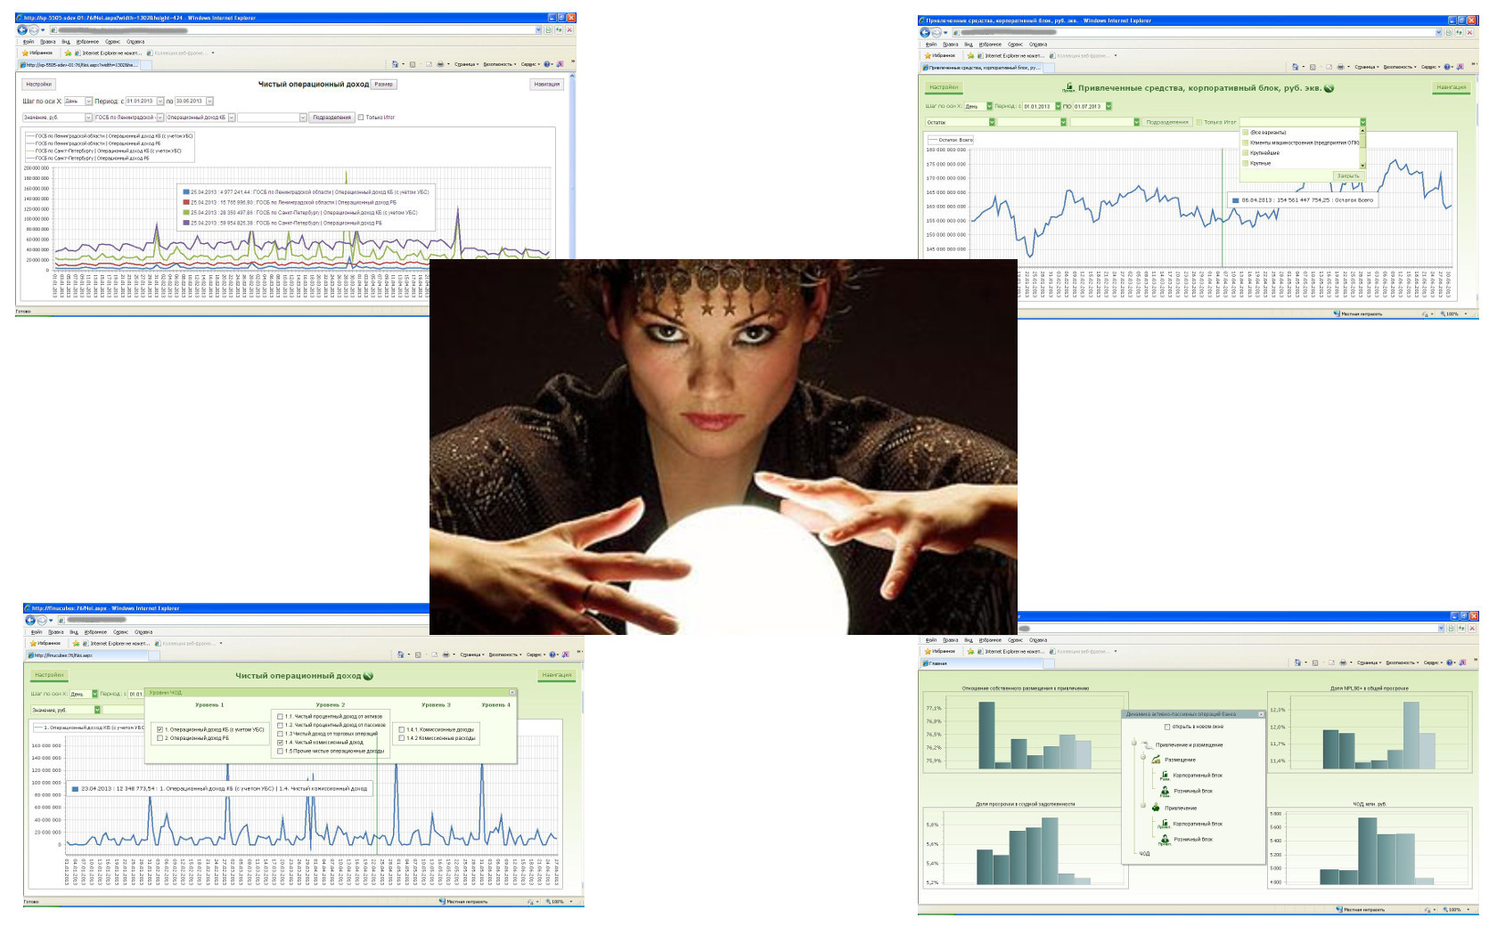
Data analysis.
Notes:
Later there occurred a need to see the dynamics of key performance indicators in the form of graphs and tables in the web browser. This was necessary for quick and intuitive analysis of the current situation. The MS Reporting service did not quite fit for this purpose, because the graphs were very detailed, and the time intervals were changing significantly. There were required graphs that could scale depending on the step size and range, as well as the opportunity to work interactively with the graph, i.e. there was a need for an opportunity to compare two indicators, or one indicator for different units, or to change the indicator for different types of product. An attempt was made to use the MS Performance Pointer for this purpose, but excessive detail and strong flexibility of this tool made ​​it very difficult for an ordinary bank employee. Therefore, to achieve this objective we developed an application using a package of the DevExpress company graphic tools to display data and the MS Analysis Services--for their processing and storage.

Slide 12
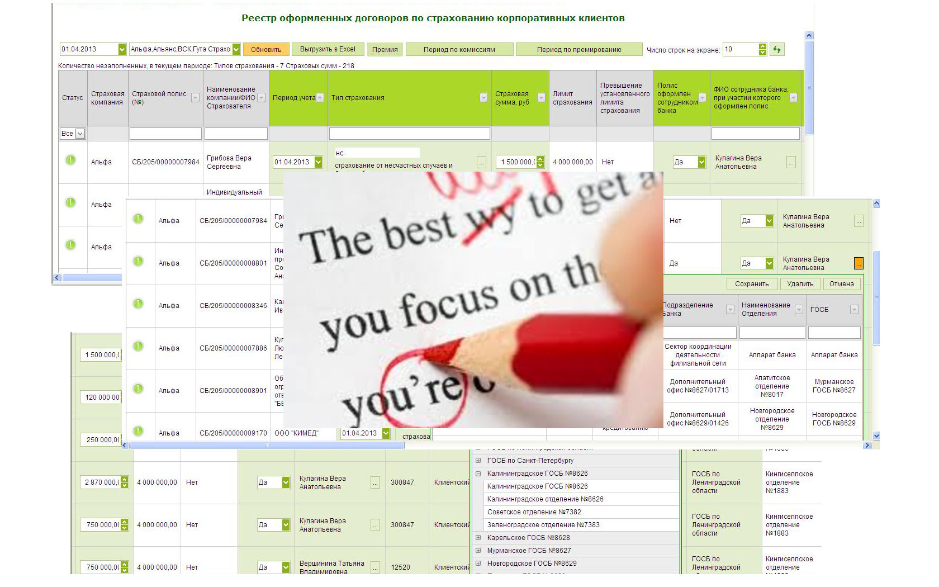
Interactive data correction.
Notes:
During the various structural and legal changes there occurred a situation when the information on the sold products was collected by an automated system for each unit, while it was required to be collected for each employee of the unit. There was developed a form in which the unit manager could indicate the names of the employees in front of each product, as well as set a number of additional parameters. Due to the large number of products we also had to develop an online form that looked like a table, editing being activated by clicking on a cell. A similar form was also used for manual matching of unrecognized commissions. Sometimes when filling in the receipts the customer makes a mistake in the organization details. These "unrecognized commissions" are filled in via the developed application.

Slide 13
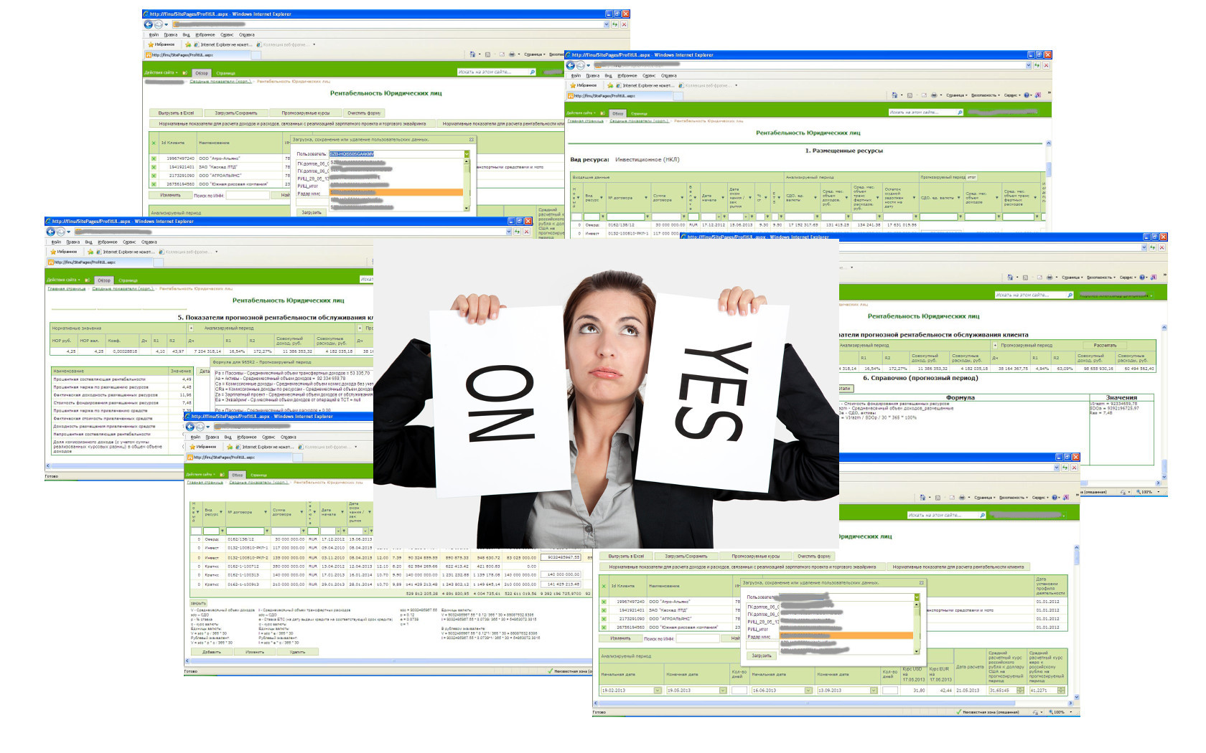
Customer’s profitability
Notes:
The next idea was to evaluate the customer's profitability through a single online form. Prior to this, three separate bank groups calculated the customer's profitability via Excel files and then compared their results in order to obtain a single estimate. It was time-consuming, although the work was largely monotonous and most of it was reduced to searching all the customer's receipts, commissions, and contracts for a certain period.
The complexity of software solution was that the profitability was evaluated based on the customer's activity for the selected period and forecasting of the same activity in the forecast period with the option to change or add a variety of items in the forecast period. During the forecast period, respectively, there were changed such external factors as the unified tariff net rate, the dollar exchange rate, etc., and the program should consider all this. In addition to the calculations, the application also involved the formatted transfer of all input and calculated data to the MS Excel, and saving the users' calculations to the database with the ability to download the calculation later by the same user or another user in the read-only mode.

Slide 14
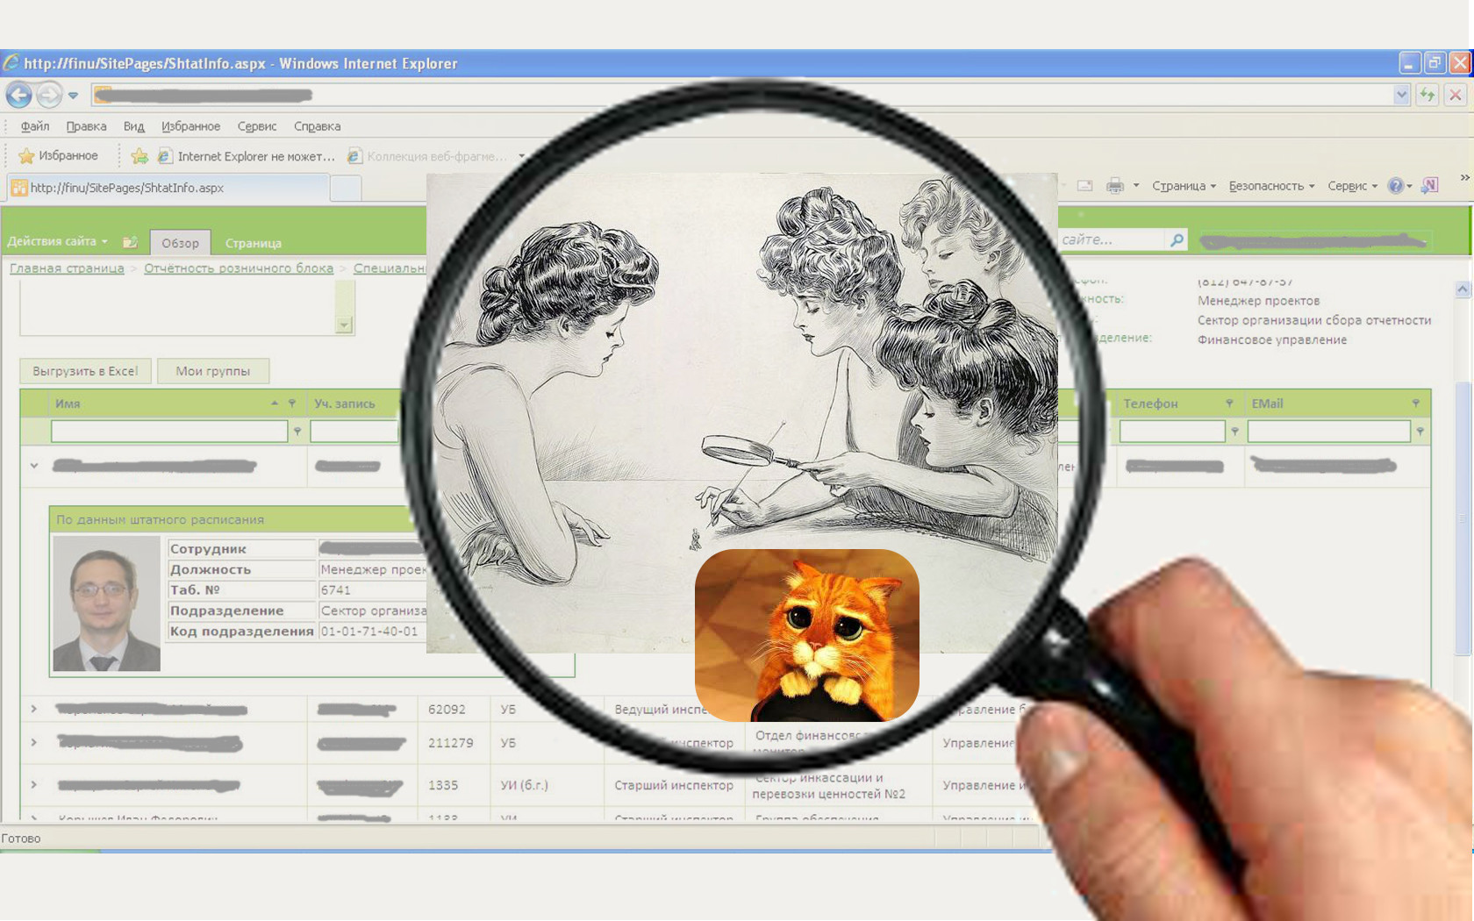
Bank employee search
Notes:
Many difficulties had to be addressed because of the complex system of access rights and security system in the bank. All employees have an Active Directory account, but also all employees have a personnel number in the Database; both the personnel number and the account can be changed, and the order of changing remains unknown. Moreover, the employees have limited access depending on the unit they work for. Besides, the employees working in the neighboring region have their own Active Directory domain. The employees can also have multiple Active Directory accounts, but one personnel number. There usually is only one Operating Account, attached to the postal address and telephone number. The personnel number is also very important, as it is attached to the employee's position. For certain types of data the access rights may depend on the position of the employee. Hence the first tool was developed to perform quick search through the list of employees. It displayed full information from the Active Directory, as well as the personnel number, the position, and the Database photo for each employee. It became possible to accurately determine the employee's active account, position, and unit. This application is now actively used to quickly search the employees' contacts as well.

